Slide 1


Green Pace
Security Policy Presentation
Developer: Emilio Hernandez

Slide 2

OVERVIEW: DEFENSE IN DEPTH
Defense in Depth is a method of protection that is used to stack layers of security

Slide 3
THREATS MATRIX
The threat matrix is used to explain and label the potential risks. This is the way they are categorized in these four options
Likely Attacks with higher severity that are more than “likely” to occur | Priority Attacks that have a high severity level should be set as our “priority” to address
Low priority Low exploitable vulnerability, lost is not major | Unlikely Attacks with lower severity that more than “unlikely” to occur

Slide 4
10 PRINCIPLES
Validate Input Data
Heed Compiler Warnings
Architect and Design for Security Policies
Keep it Simple
Default Deny
Adhere to the Principle of Least Privilege
Sanitize Data Sent to Other Systems
Practice Defense in Depth
Use Effective Quality Assurance Techniques
Adopt a Secure Coding Standard

Slide 5
CODING STANDARDS
Obey the One-Definition Rule
Do not write syntactically ambiguous declarations
Guarantee that storage for strings has sufficient space for character data and the null terminator
Prevent SQL injection
Close files when they are no longer needed
Do not access an object outside of its lifetime
Do no access fredd memory
Handle all exceptions
Gracefully handle self-copy assignment
Avoid deadlock by locking in a predefined order

Slide 6
ENCRYPTION POLICIES
Encryption At Rest: Stored data protected by software or firewalls
Encryption At Flight: Data being sent is protected by encryption
Encryption In Use: Data is secured at rest, in flight or in use

Slide 7
TRIPLE-A POLICIES
Authentication: Verification of the identity of a user, system or entity
Username, Passwords, MFA
Authorization: Granting or denying access rights and permissions to authenticated users
- Principle of least privilege
Accounting: Tracking and logging activities for accountability and auditing
- Logging user activity

Slide 8
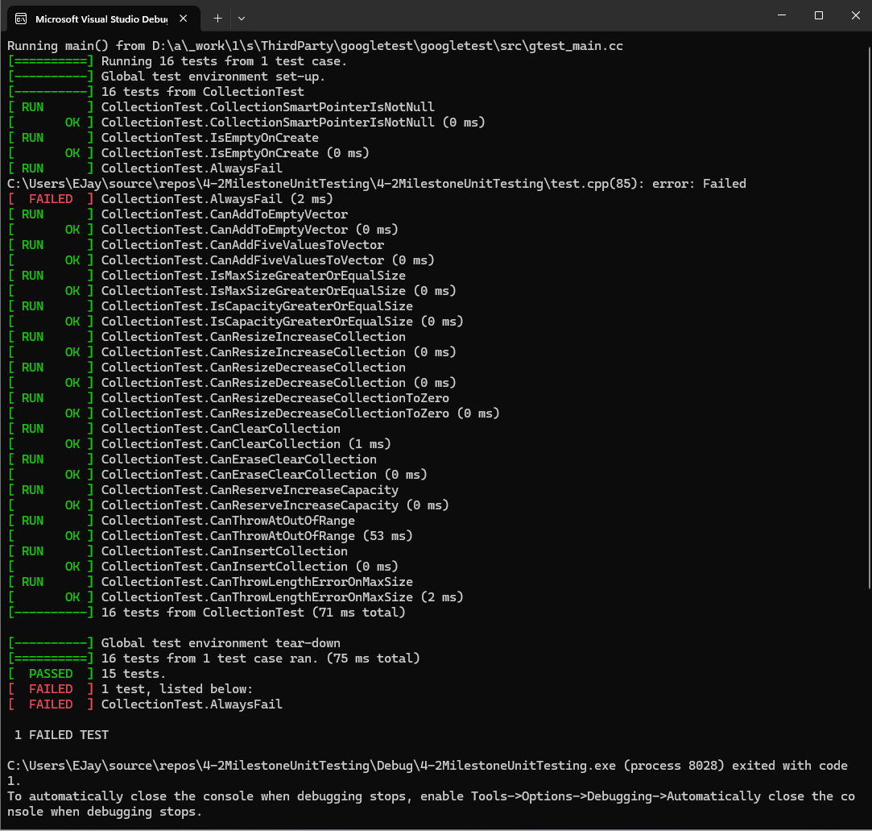
Unit Testing
I ran a bunch of tests like always fail to check the validity of the debug software. I also added ways to check to see if a new collection would be made in a new file. This also allowed me to check to see if I was able to check of files were added to collection and if I could remove a file. I also added a test to throw an error if the user input was longer then the max size.

Slide 9

AUTOMATION SUMMARY

Slide 10
TOOLS
The DevSecOps pipeline acts as the backbone to the development process by integrating development, security, and operation into a streamlined workflow.
Git – Source Code Repository

Slide 11
RISKS AND BENEFITS
Problem: “Our security strategy is showing signs of gaps, potentially leaving us vulnerable to threats.”
Solution: Conduct a thorough security review to identify and address existing vulnerabilities and gaps.
The Benefit: Immediate strengthening of our security posture, reducing the likelihood of breaches.
The Risk: Potential disruption to ongoing projects due to security updates.

Slide 12
RECOMMENDATIONS
Identifying Gaps:
Regular software testing uncovers potential security weaknesses.
Gaps may include being unprepared for cyber attacks and facing new threats.
Types of Gaps:
Unpreparedness for cyber attacks
Encounter of new threats
Low defense levels
Lack of diversity in defense layers
Recommendations:
Test Often
Use Best Practices
Monitor Software
Diverse Protection

Slide 13
CONCLUSIONS
Trust: Security is the bedrock of trust. If we are proactively identifying and addressing potential gaps, we ensure the security if our users' data.
Emerging Trends: When we are innovating it is important that we stay ahead of potential threats so we can work towards a better future while putting security at the forefront of innovation.
Client Forward: This is how we continue to build software with the importance of client security as the most important responsibility we have as developers.

Slide 14
REFERENCES
Top 10 Secure Coding Practices - CERT Secure Coding - Confluence. (n.d.). Wiki.sei.cmu.edu. https://wiki.sei.cmu.edu/confluence/display/seccode/Top+10+Secure+ Coding+Practices?focusedCommentId=88044413
TylerMSFT. (2021, August 3). Security Best Practices for C++. Learn.microsoft.com. https://learn.microsoft.com/en- us/cpp/security/security-best-practices-for- cpp?view=msvc-170&viewFallbackFrom=vs-2019
‌

